Slide 1

2026-27
Bruce Middle & High School
Co-Curricular Code of
Conduct Informational Meeting

Slide 2
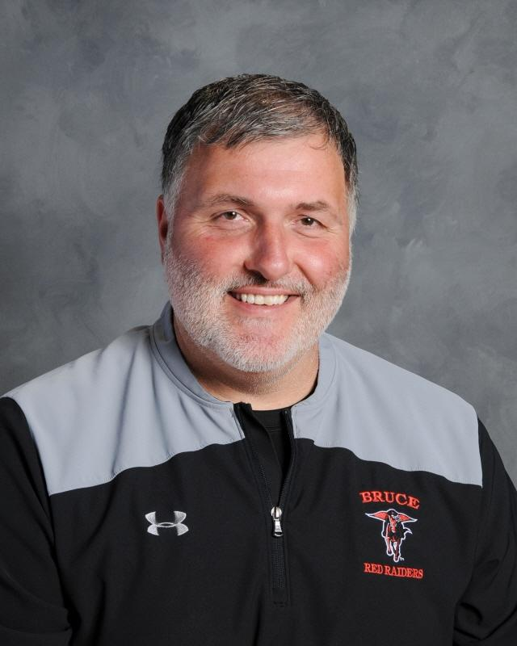
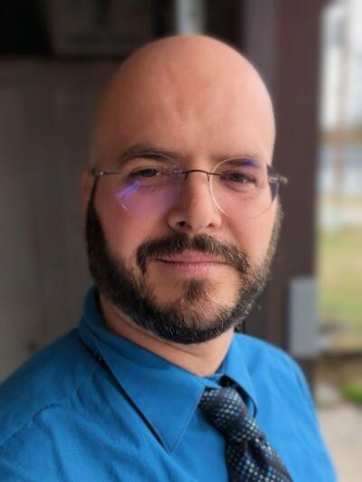
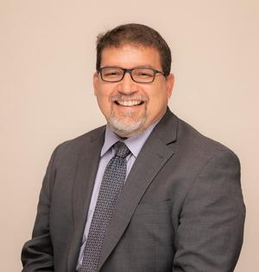
Who’s Who in Bruce Athletics…
Sandrai Hause
Athletic Secretary
HS Secretary
shause@bruce.k12.wi.us
Kendra Cariiion
Secretary
kcarillon@bruce.k12.wi.us
Emily Gudis
Finance
egudis@bruce.k12.wi.us
Jason Lehman
MS/HS Tech Ed
Head Boys Basketball
Athletic Director
jml@bruce.k12.wi.us
Travis Augustine
MS/HS Principal
taugustine@bruce.k12.wi.us
Anthony Bosco
Superintendent

Slide 3
Who’s Who in BHS Athletics…
Head Coaches
Fall Coaches Winter Coaches
Cross Country – Jodi Heiny Boys Basketball – Jason Lehman, Ast. ?
Football – Adam Malinowski, Todd Roehl, Girls Basketball – Karleigh Olson & Conner Kopras
Jake Thome Boys and Girls Wrestling - ?
Volleyball – Karlie Kopras & Karleigh Olson
Spring Coaches
Boys and Girls Track – Jodi Heiny & Dustin Thompson
Baseball – ?
Softball – ?

Slide 4
Who’s Who in BMS Athletics…
Coaches
Fall MS Coaches Winter MS Coaches
Cross Country – Ronda Osuldsen Boys Basketball – Jake Thome & Cody Felske
Football – Paul Wester & Cody Felske Girls Basketball – Natalie Krezinski & Raya Schindler
Volleyball – Brooke Wiles & Natalie Krezinski Boys and Girls Wrestling - Bubba & Emily Gudis
Greg Tangen
Spring MS Coaches
Boys and Girls Track – Meghan Thompson & TBD

Slide 5
Who’s Who in BHS Activities…
Advisors/Coaches
FBLA– Shelby Johnson
FFA – Stephanie Besaw
Forensics – Curt Strek
Ice Fishing Team – Anthony Bosco
MS/HS Play – Rick Snyder
Math Club – Rick Vollendorf
(NHS) National Honor Society– Rick Vollendorf
Robotics/ESports – Jon Wallner
Skills USA – Jerry Dearhamer
Student Council – Curt Strek
Trap Shooting – Bart Vitcenda, Kristi Blodgett, Eric Lee, Alison Henson
Yearbook – Cassie Sutten

Slide 6
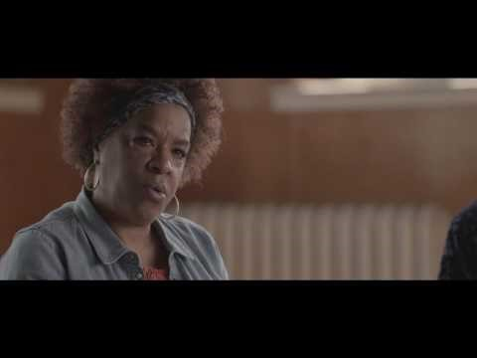
Parents sometimes have the toughest job..
Please Click to View Video

Slide 7

Parents: A Child’s First Coach…

Slide 8

Parents: A Child’s First Coach… Tips for supporting your child

Slide 9
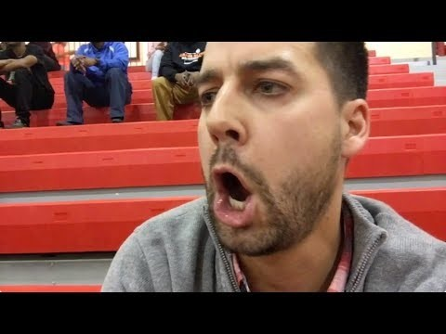
The Purpose of Co-Curricular Activities…it’s about the KIDS
Please Click to View Video

Slide 10

SPORTSMANSHIP

Slide 11
The Purpose of Co-Curricular Activities:
Life Skills/Expectations
Teamwork, perseverance, discipline, responsibility, physical endurance, work ethic, commitment, time management, & personal/emotional health
  Commitment involves dedicating yourself to something, like a person or a cause. A Commitment OBLIGATES you to do something
  TEAM: Together Everyone Achieves More
    Change the “Me” to “We”… What’s in the best interest of the team, how can I help the team be successful.
    Teamwork is essential for success in Life!
      TEAMWORK MAKES THE DREAM WORK!
    Attitude and Leadership
      In Classroom/Out of Classroom
      On Field/Off Field
What it means to be a Bruce Red Raider: RESPECT, HONESTY, WISDOM, FORTITUDE, AND HUMILITY

Slide 12
Supportive Role of Fans
Supportive Behavior in Stands
  Keep it Positive
  Impact on your own child and team
Communication with Coaches
  Athlete and Coach First
  24 Hour Rule…
Ask your Athlete
Any fan ejected from a game must take sportsmanship course in order to attend another event per WIAA rules starting July 1, 2025

Slide 13
Each year the Bruce Athletic Boosters Support BMHS Athletics and student athletes by giving back. Here are some of the things that funds were given for in the past…
Increased amount paying out to Clubs working concession stands
Updating the Baseball Concession Stand
Upgraded Equipment within the concession stands
Funded Aces Punt, Pass, and Kick
Christmas Gift Shop this coming year
Currently getting Padding on North wall of the gymnasium

Slide 14
Contact an Athletic Booster officer to learn more OR attend their next meeting:
Next Booster Club Meeting:
Aug 13th, 6:00pm in the Health Ed Classroom
President: Whitney Trott
Treasurer: Jana Nyhagen
Secretary: Roxie Kemmitz
Contact Whitney Trott @ brucebooster@icloud.com

Slide 15
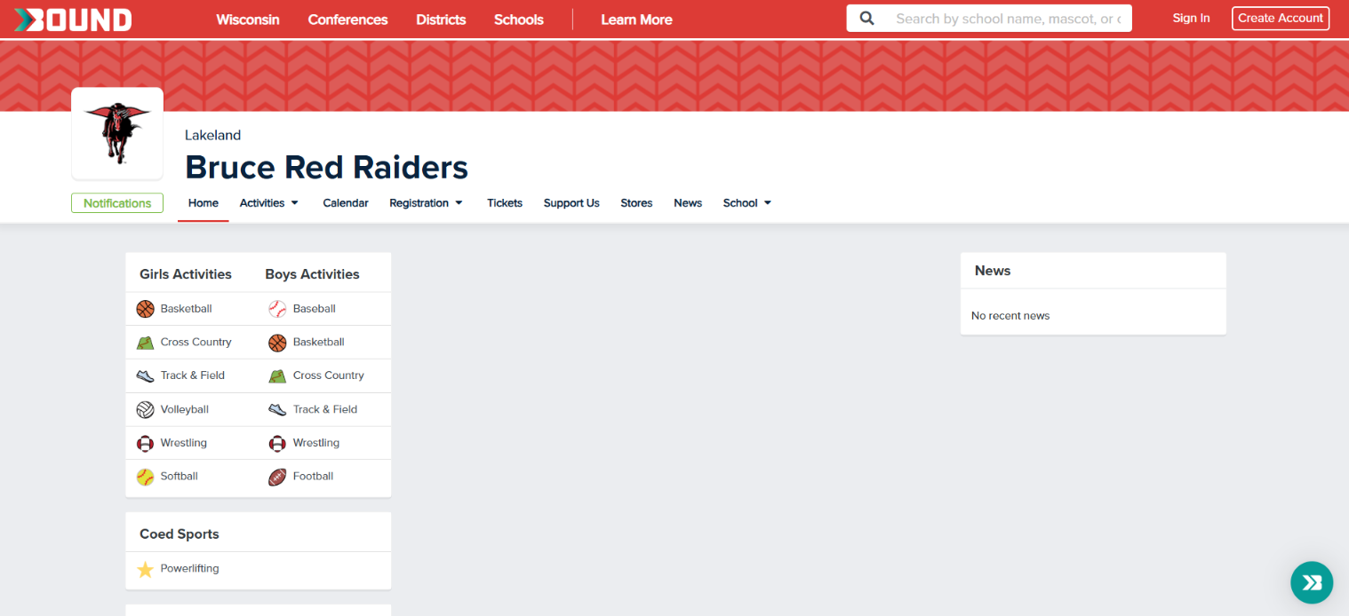
Attend Athletic Events: BMHS Athletic Schedule
Use Bound Website to stay connected to current sports schedules
Eventually Bound should be linked to the new School Website

Slide 16
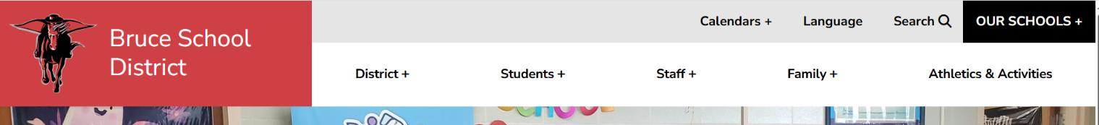

Attend Athletic Events: BMHS Athletic Schedule
Click Athletics & Activities you will then be taken to the Athletics Page
Once on Athletic Page, you will eventually be able to check the Booster Club information, go to team pages under the Athletics Tab. Also find information under the Activities tab for Clubs such as Robotics, FFA, etc. The Calendars for each sport can be found under the specific sports tabs

Slide 17

Attend Athletic Events: BMHS Athletic Schedule
Otherwise click on Calendars and then Athletics and it will take you to the Bound athletic Calendar

Slide 18


Become a WIAA Official…visit: https://www.wiaawi.org/Officials/Become-an-Official

Slide 19


Follow the School District on the following:
Bruce School District
@bruceschooldistrict

Slide 20
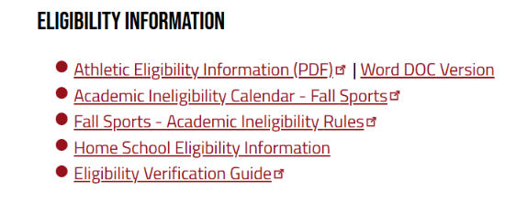
WIAA Eligibility Information:
2026-2027 High School Athletic Eligibility Information Bulletin
Do we have any transfers that are Juniors or Seniors?

Slide 21
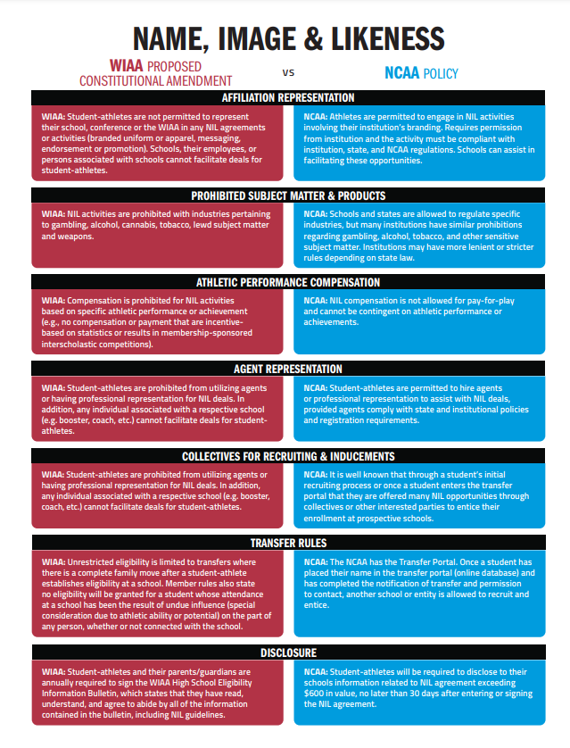
NIL at a Glance

Slide 22
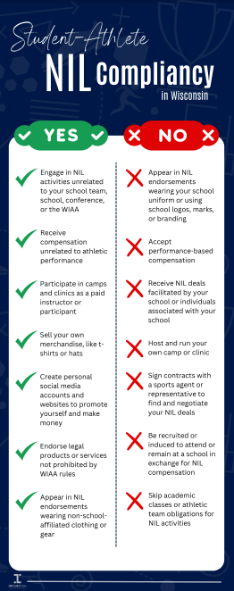
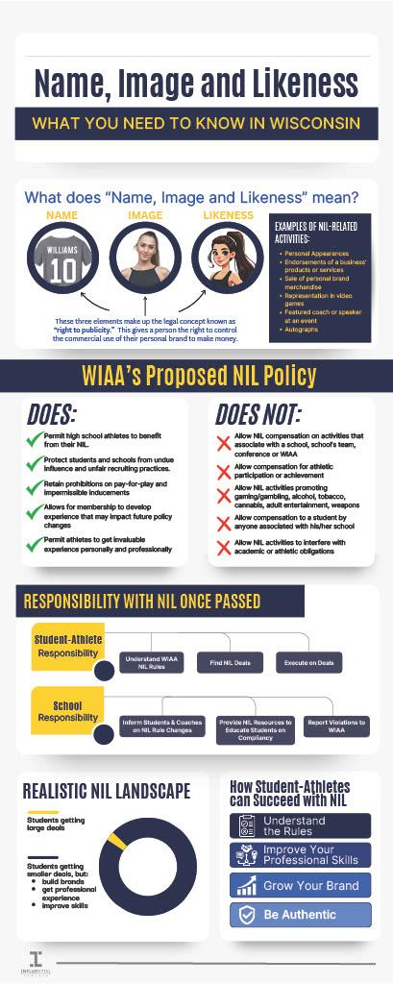
NIL at a Glance

Slide 23
Co-Curricular Activities are a Privilege:
Bruce Athletic Code
24 Hr Policy

Slide 24
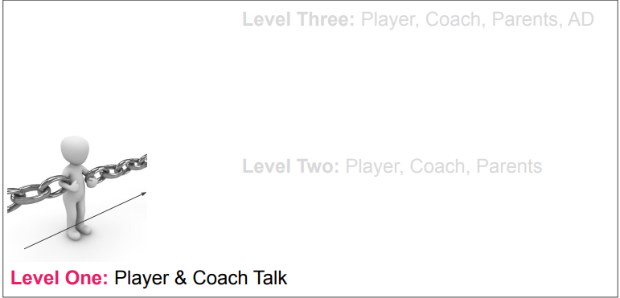
The Communication Chain

Slide 25
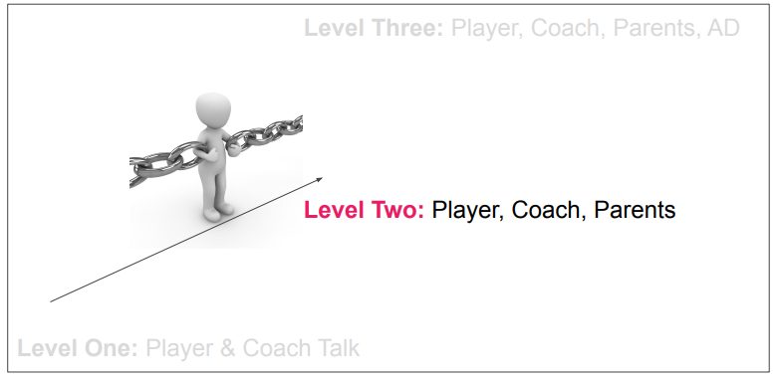
The Communication Chain

Slide 26
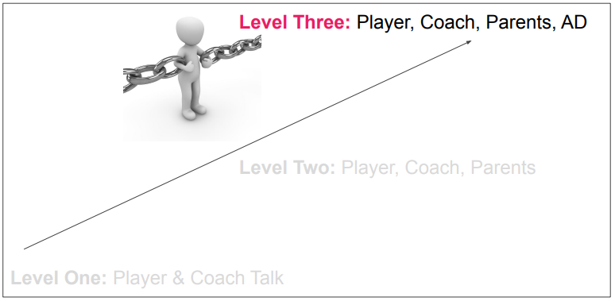
The Communication Chain

Slide 27
Alternate Year Card & Physical Form
Please click the link for the Alternate Year Card or the Physical Form based on what your child needs.
Upload on Bound: Page 4 Medical Eligibility Form
Athletic Alternate Year Card Link
WIAA Physical Form
All Paper Physical Forms must be brought and turned into Jason Lehman or Sandra Hause in main office, or your coach so that they can give to me.

Slide 28
Concussion Information Links
Concussion Information from the WIAA
https://www.wiaawi.org/athletic-resources/health-safety/concussion
Info for athletes, parents, officials
Policy
Return to Play
Courses
Law
Management Resources
Insurance
Sudden Cardiac Arrest

Slide 29
Paperwork to Turn In during Bound Registration:
Transportation Form,
WIAA Athletic Eligibility Agreement
Bruce Co-Curricular Code agreement,
Concussion Awareness/Cardiac Arrest Agreement,
Emergency Release Authorization Form,
Pre-Athletic Physical Form Page 4,
Alternate Year Card

Slide 30
Fall Apparel Information
Fall Apparel will be available to order is going on now
All orders will be done online so keep an eye out on our school website and social media pages.
Paperwork to remind you will be send home during open house- August 26th from 4pm-7pm.

Slide 31

Any Questions?
Reminder to all athletes - Bring Your Own Water Bottle!

Slide 32

WIAA and Dick’s Sporting Goods
https://cmm.dickssportinggoods.com/crmcdn/getoffer.aspx?offer_entity_code=O241FVZL&token=u8qvw04UbtPQ4ynjT7irvhaW5Z7gVPo72RYsxB7ONSDDBnFSYqkBorSmBlgyOk04FZJ5VEYvXnNHvAzVNijDxw2&p=true&vt=46217.6407526968&vth=FHR5a7M8exASLwG0cfoRuk67mY9bGmBQCkk83CKH8q5jEqWy6njDsOz8NU-7IfCiefx0uTiu-iDO4pi0UQgA2&utm_medium=email&_hsenc=p2ANqtz-8KgYk4gIs0UaTlNYYh6R4aWcJNc5SoYMOOYHQh4zs58iSzr_nLm7M3_mc7G3BinallaDdkHrjo5nJNtbxflK4-zLFUQg&_hsmi=430884905&utm_content=430884905&utm_source=hs_email

Slide 33
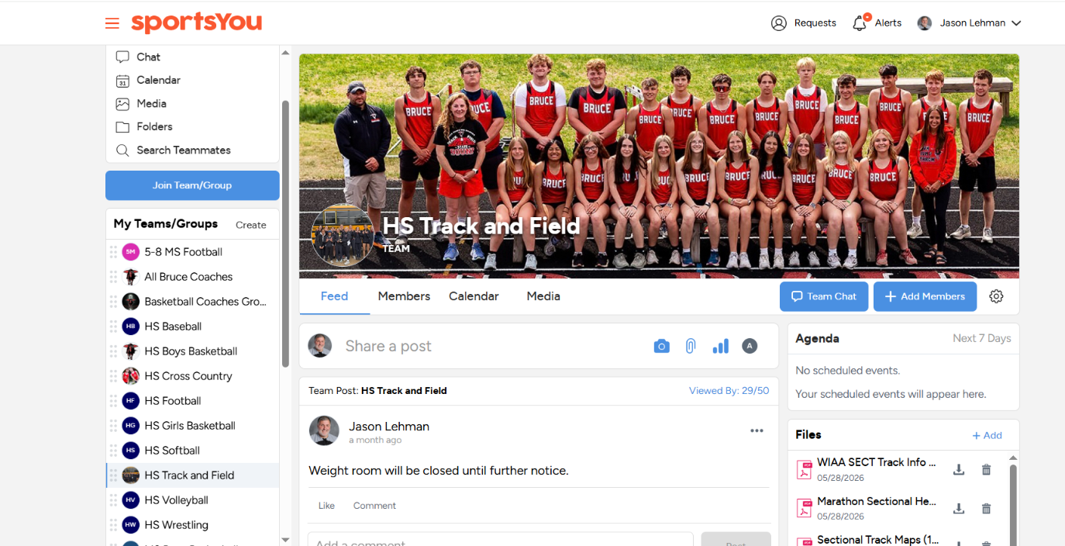
Team Messaging and Contact
SportsYou App
https://sportsyou.com/
Update from Superintendent - No personal texts or messages, student contact will be made through SportsYou, School Email, Infinite Campus, or Google Suite (like Classroom, etc.). This will be School Wide!!

Slide 34
BOUND REGISTRATION
Setting Up Accounts
This will be a little bit of a process this first year.
Some of the documents may seem redundant, but again it is mainly for the first year and getting your account set up.
You will get updates and notifications for any sport that you are signed up for, select those sports to receive notifications
You should receive notifications moving from year to year if your Physical is coming due.
Bookmark the Bruce HS Bound Website to stay up to date on school athletic and Activities

Slide 35
Setting up Family and Student Account and Registering for Activities
Setting up Family Account in Mobile App
https://intercom.help/boundhq/en/articles/14624301-how-to-create-a-family-account-mobile-app
How to add student to second family using Web Browser
https://intercom.help/boundhq/en/articles/13687609-how-to-add-a-student-to-a-second-family-web-browser
Registering Students for Activities in the Mobile App
https://inhttps://intercom.help/school-public---bound-help-center/en/articles/13315607-register-for-an-activity-mobile-apptercom.help/school-public---bound-help-center/en/articles/13315607-register-for-an-activity-mobile-app
Registering Student for an Activity using Web Browser
https://intercom.help/boundhq/en/articles/7934242-register-a-student-for-an-activity-web-browser

Slide 36
Uploading documents on Web Browser
Uploading Documents (ie, Physicals, etc)
https://intercom.help/boundhq/en/articles/8288335-how-to-upload-a-physical-web-browser
How to upload a replacement for a rejected document to your student (web browser)
https://intercom.help/boundhq/en/articles/13861889-how-to-upload-a-replacement-for-a-rejected-document-to-your-student-web-browser
This may happen if you upload the wrong form, a date is wrong, or maybe a document is not signed. I personally have to go through all the paperwork that is submitted and mark if it is ok or not.
Each student must have all paperwork in and I must mark them complete and active before a student may start practices or competitions.

